Slide 1


Site-specific hydration and dehydration of San Carlos olivine
Elizabeth Ferriss
Associate research scientist LDEO, Columbia University
AGU, 2016

Slide 2
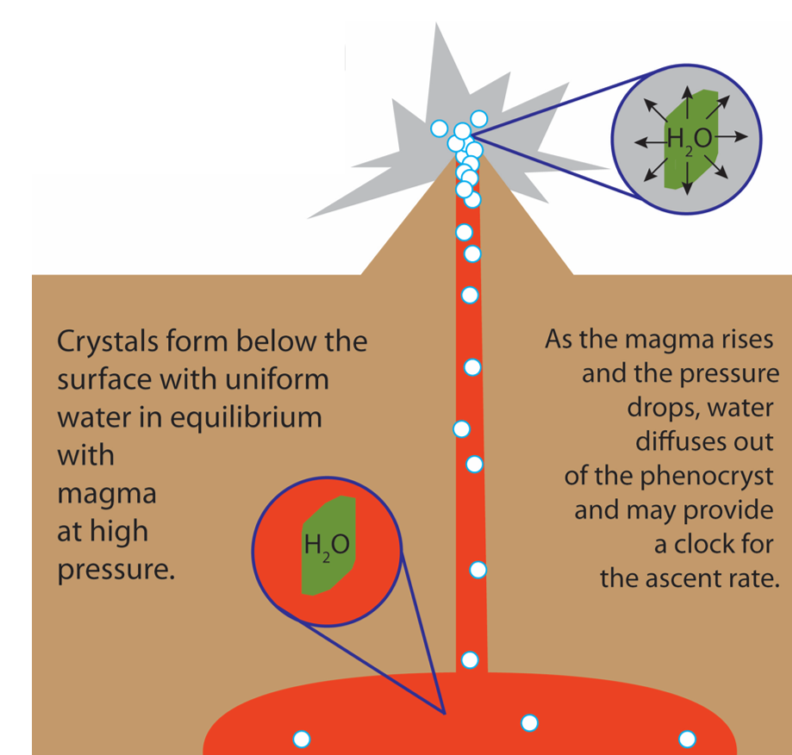
A few applications of water diffusivity in olivine
Geospeedometry
Understanding and quantifying the deep Earth water cycle, mantle rheology, magnetotellurics
Reassurance that water did not leak in or out of your melt inclusions or xenoliths

Slide 3
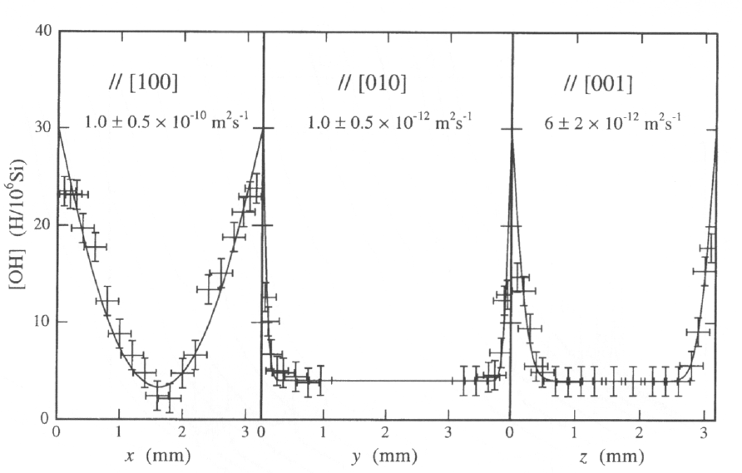
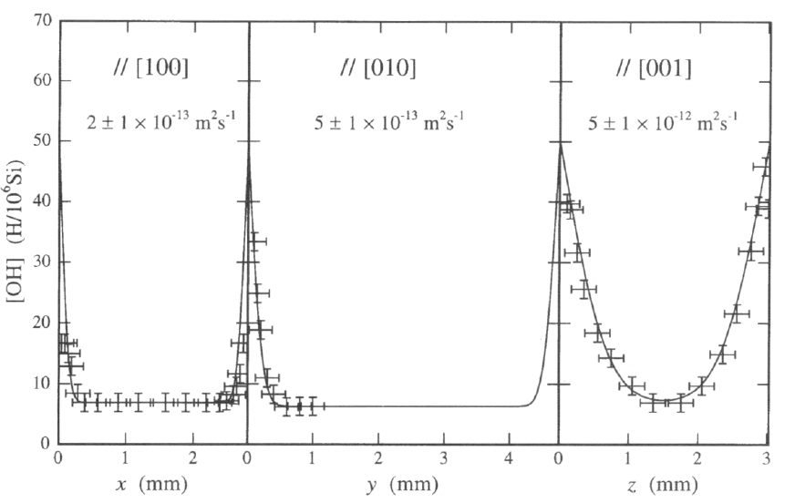
Complication 1 There are multiple stages with different rates and diffusive anisotropy
Fast “proton-polaron” or “pp” mechanism
Measure of water content
Slow “proton-vacancy” or “pv” mechanism
Measure of water content
Kohlstedt and Mackwell 1998; Demouchy and Mackwell 2006

Slide 4
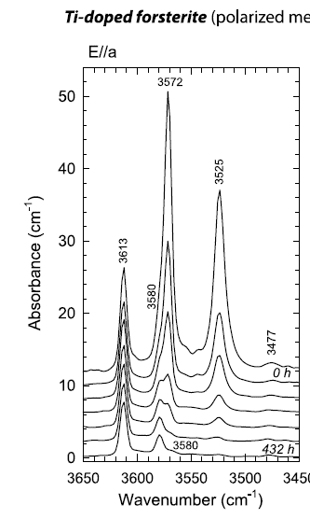
Complication 2 “Water” is really H⁺, which can vary in its diffusivity depending on how the H⁺ is incorporated
Individual peaks in the FTIR (Fourier transform infrared) spectrum represent different H⁺ incorporation mechanisms
3613 cm⁻¹ [Si] (4H⁺)_{Si} - slowest
3525, 3572 cm⁻¹ [Ti] (Ti⁴⁺)_{Mg}(2H⁺)_{Si}
900 °C
Berry et al., 2005; Padrón-Navarta et al., 2014

Slide 5
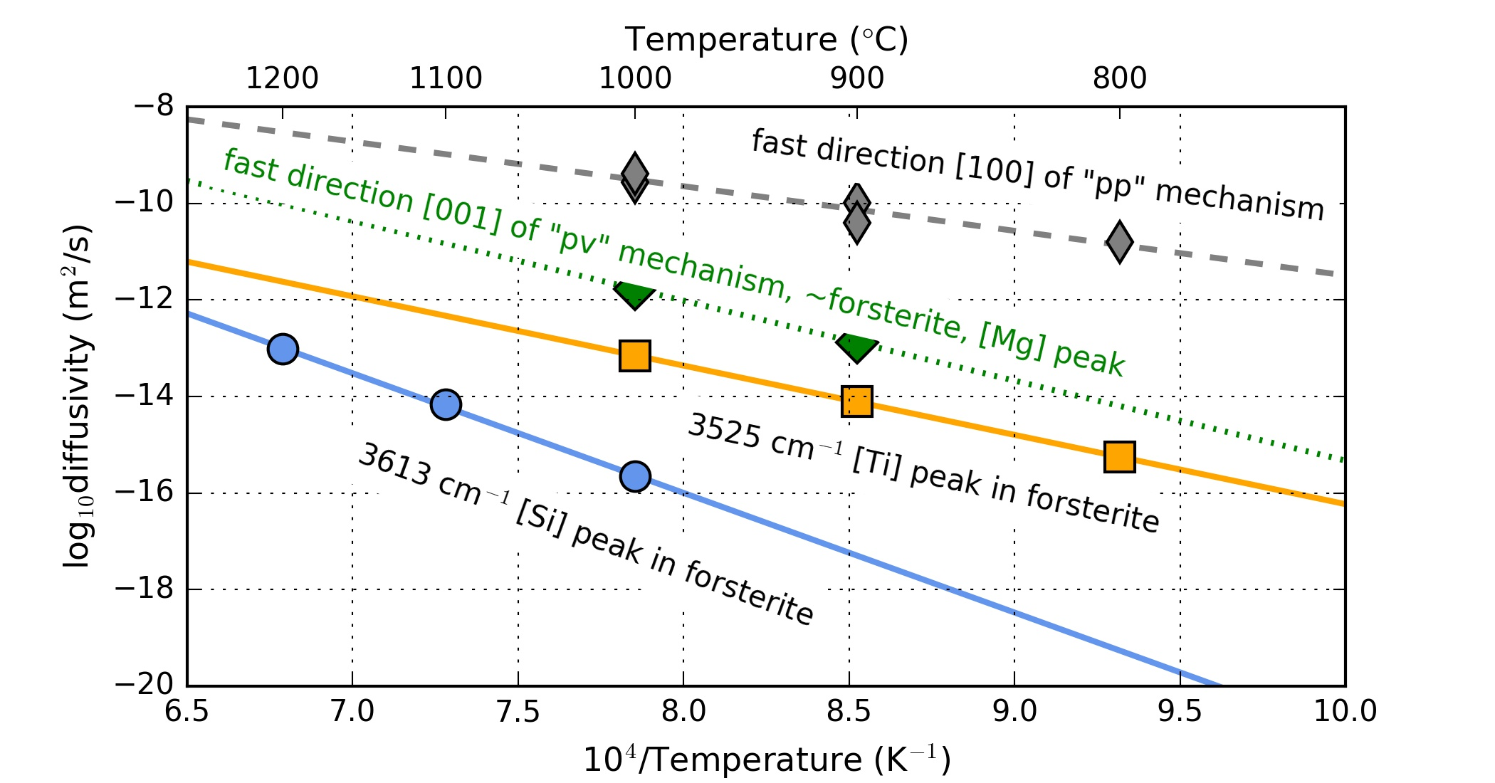
Kohlstedt & Mackwell, 1998, Demouchy & Mackwell 2003 and 2006, Padrón-Navarta et al., 2014

Slide 6
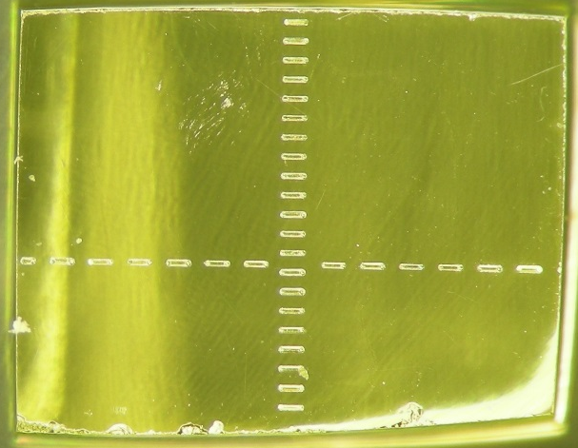
San Carlos olivine
Oriented with Laue Camera at Cornell
100 μm lines made using laser associated with LA-ICP-MS at Lamont

Slide 7
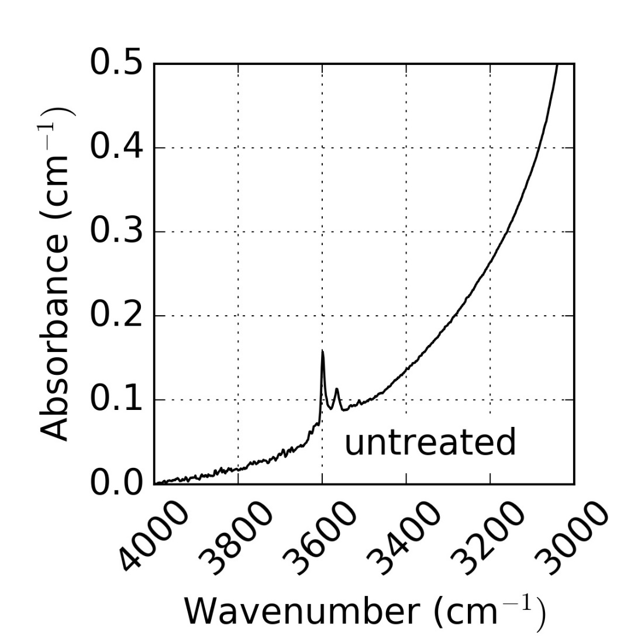
Oriented San Carlos olivine block FTIR spectrum polarized with E || [100]

Slide 8
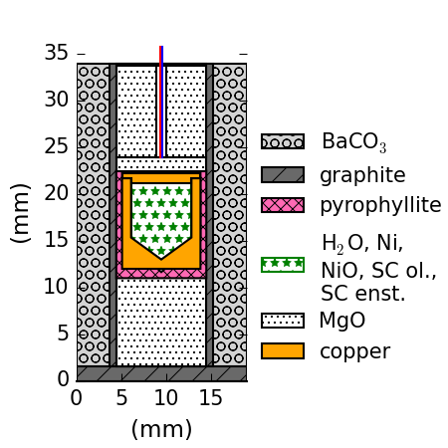
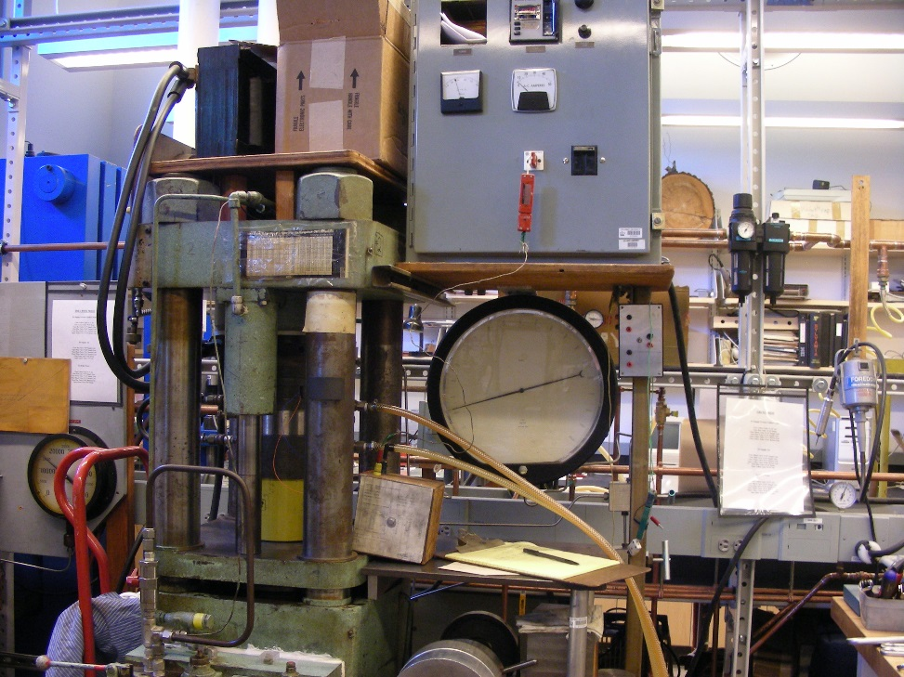
Experiments
Hydration
Piston cylinder apparatus 800 °C, 10kbar, 1.9 GPa H₂O fugacity

Slide 9
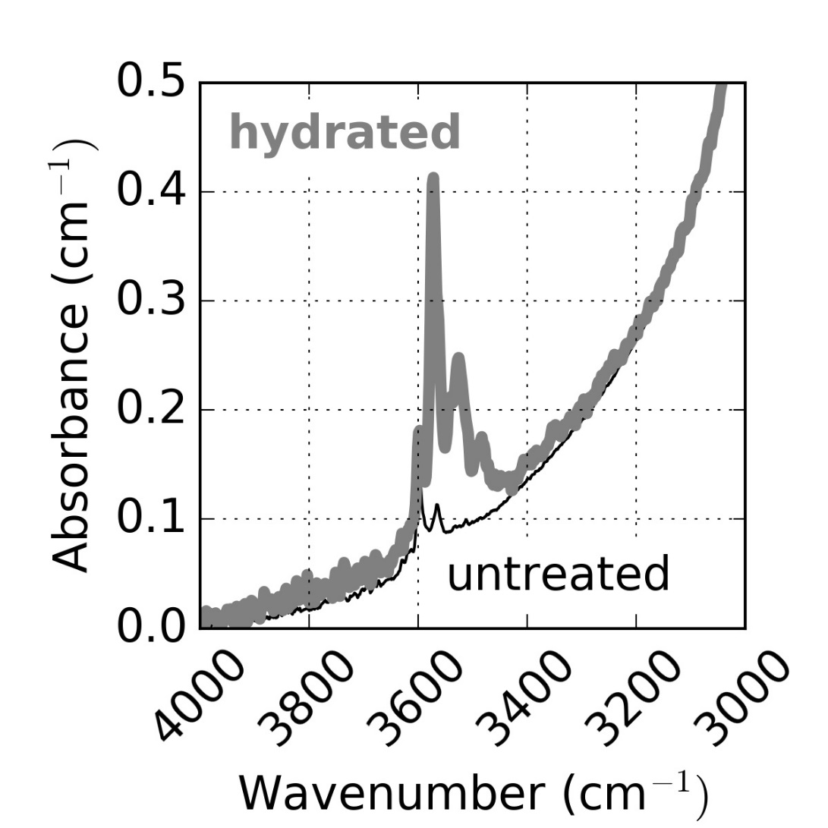
Oriented San Carlos olivine block FTIR spectrum polarized with E || [100]

Slide 10
Water diffusion in olivine starts out fast
Initially-dry San Carlos olivine
hydrated 1 hour
900°C
Fe-FeO
300 MPa
Fast direction
Measure of water concentration based on FTIR peak area
Mackwell & Kohlstedt 1990; Kohlstedt & Mackwell 1998

Slide 11
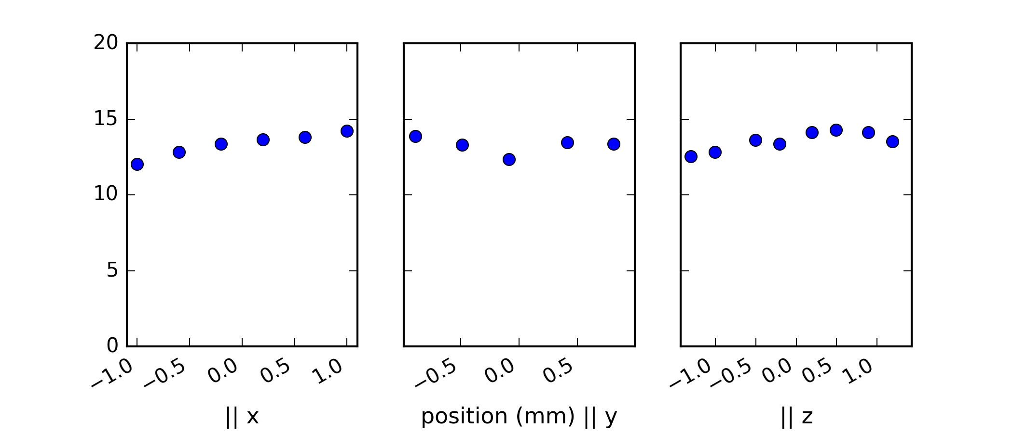
Hydrated San Carlos olivine
Total FTIR peak area

Slide 12
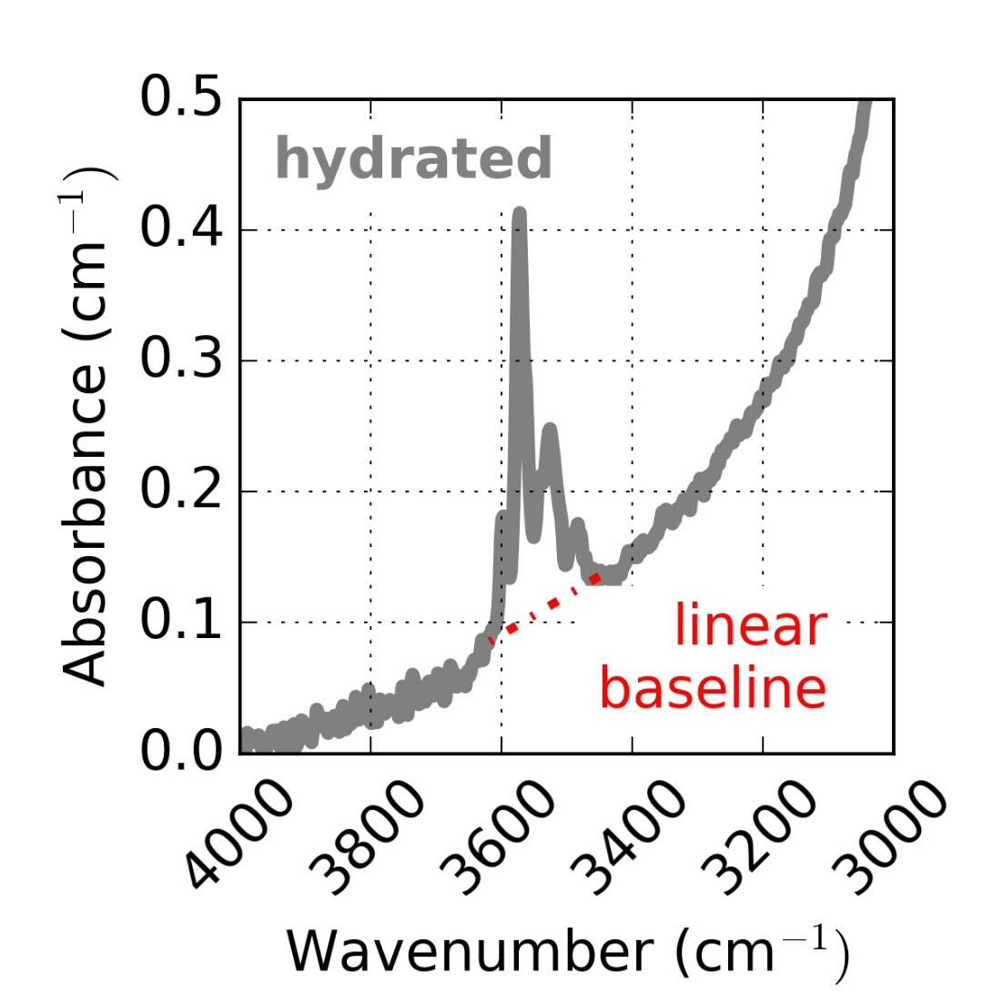
Oriented San Carlos olivine block hydrated FTIR spectrum polarized with E || [100]

Slide 13
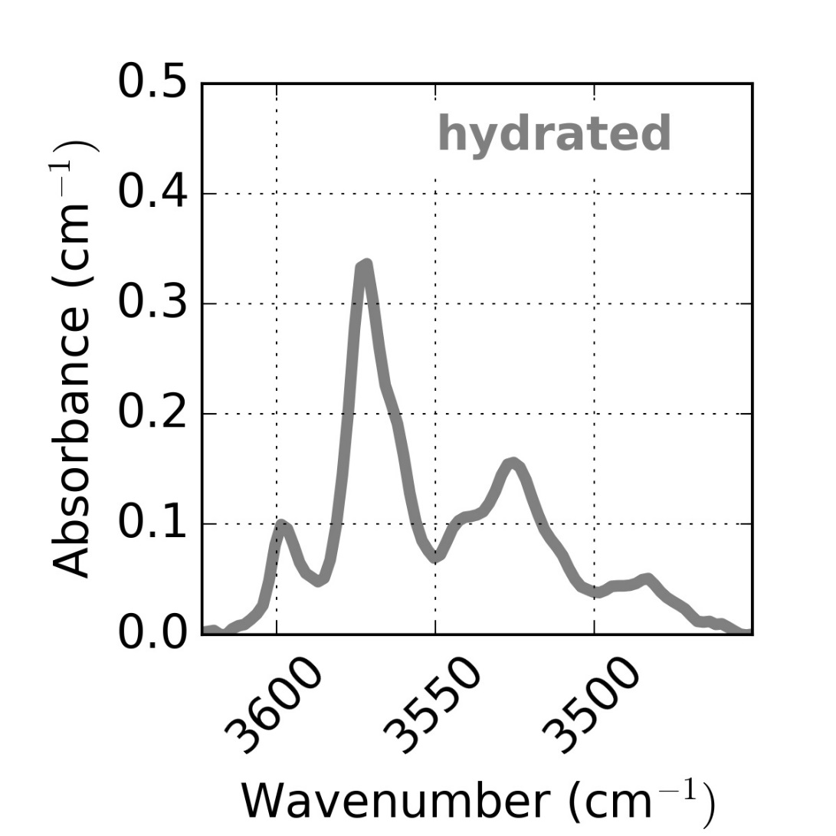
Oriented San Carlos olivine block FTIR spectrum polarized with E || [100]

Slide 14
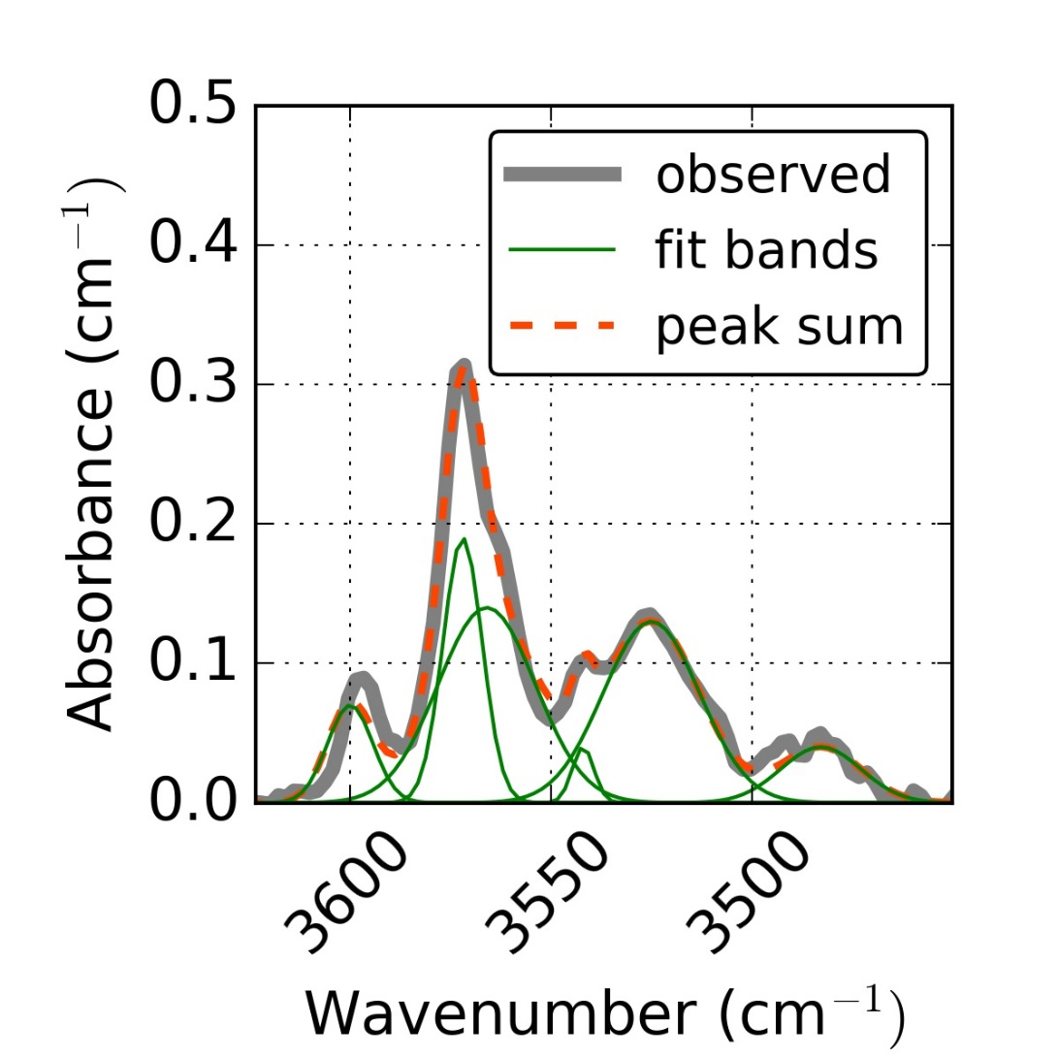
Oriented San Carlos olivine block FTIR spectrum polarized with E || [100]

Slide 15
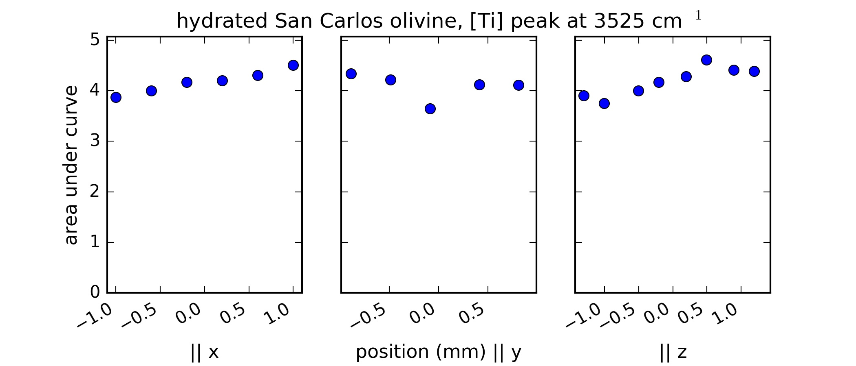


Slide 16
The same [Ti] peak
Kohlstedt & Mackwell, 1998, Demouchy & Mackwell 2003 and 2006, Padrón-Navarta et al., 2014

Slide 17
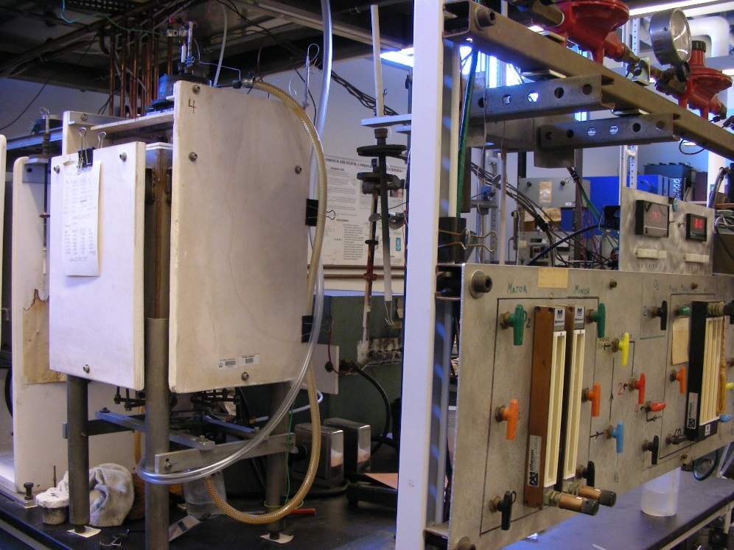
Experiments
Hydration
Dehydration
Piston cylinder apparatus
Gas mixing furnace CO/CO₂ set near Ni-NiO, 1 atm

Slide 18
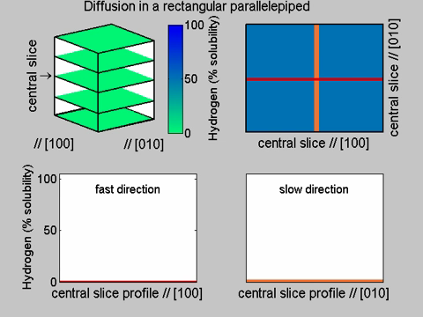
Measuring diffusion by FTIR in a block without cutting the sample
Ferriss et al., 2015
Notes:
Anisotropic.m

Slide 19
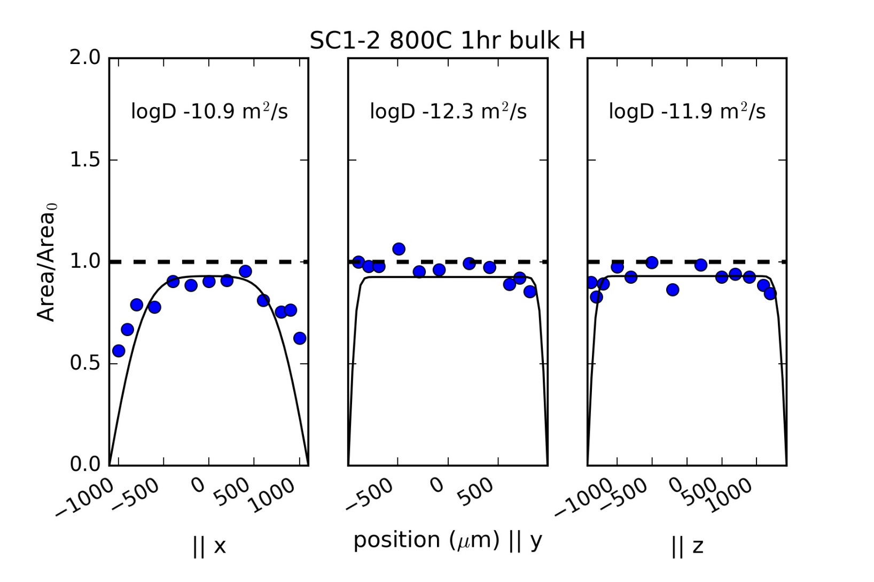

Slide 20
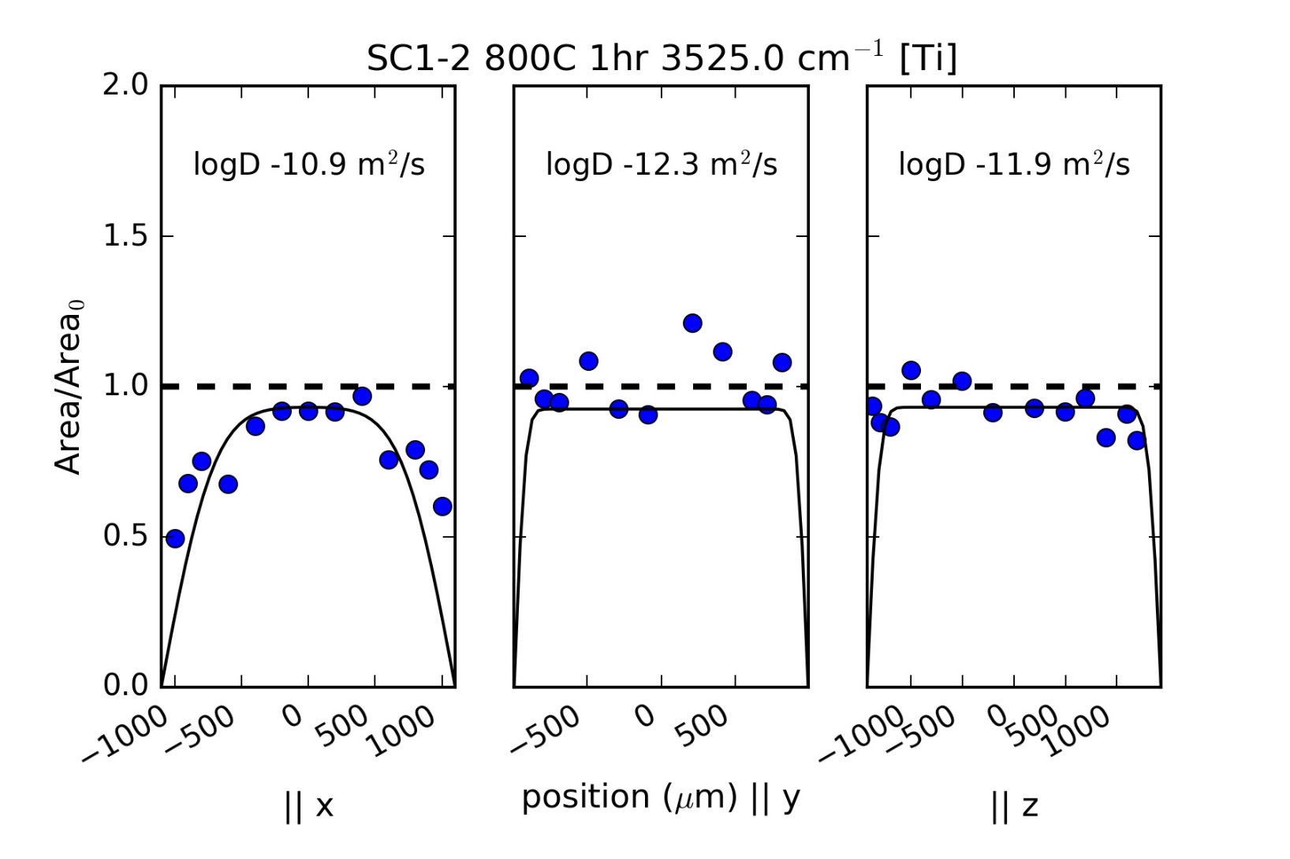
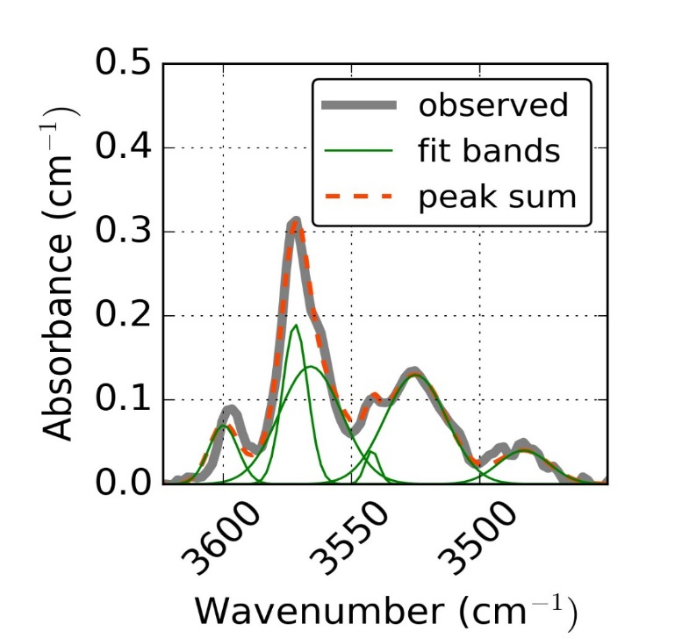

Slide 21
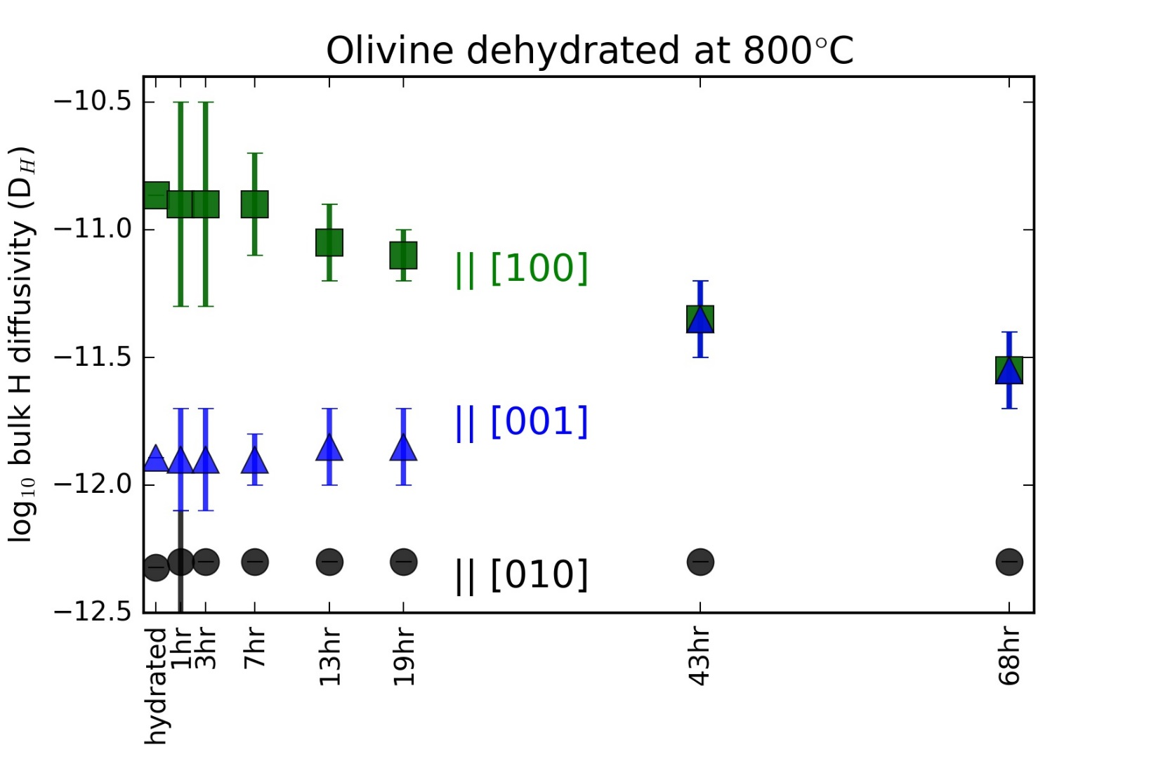

Slide 22
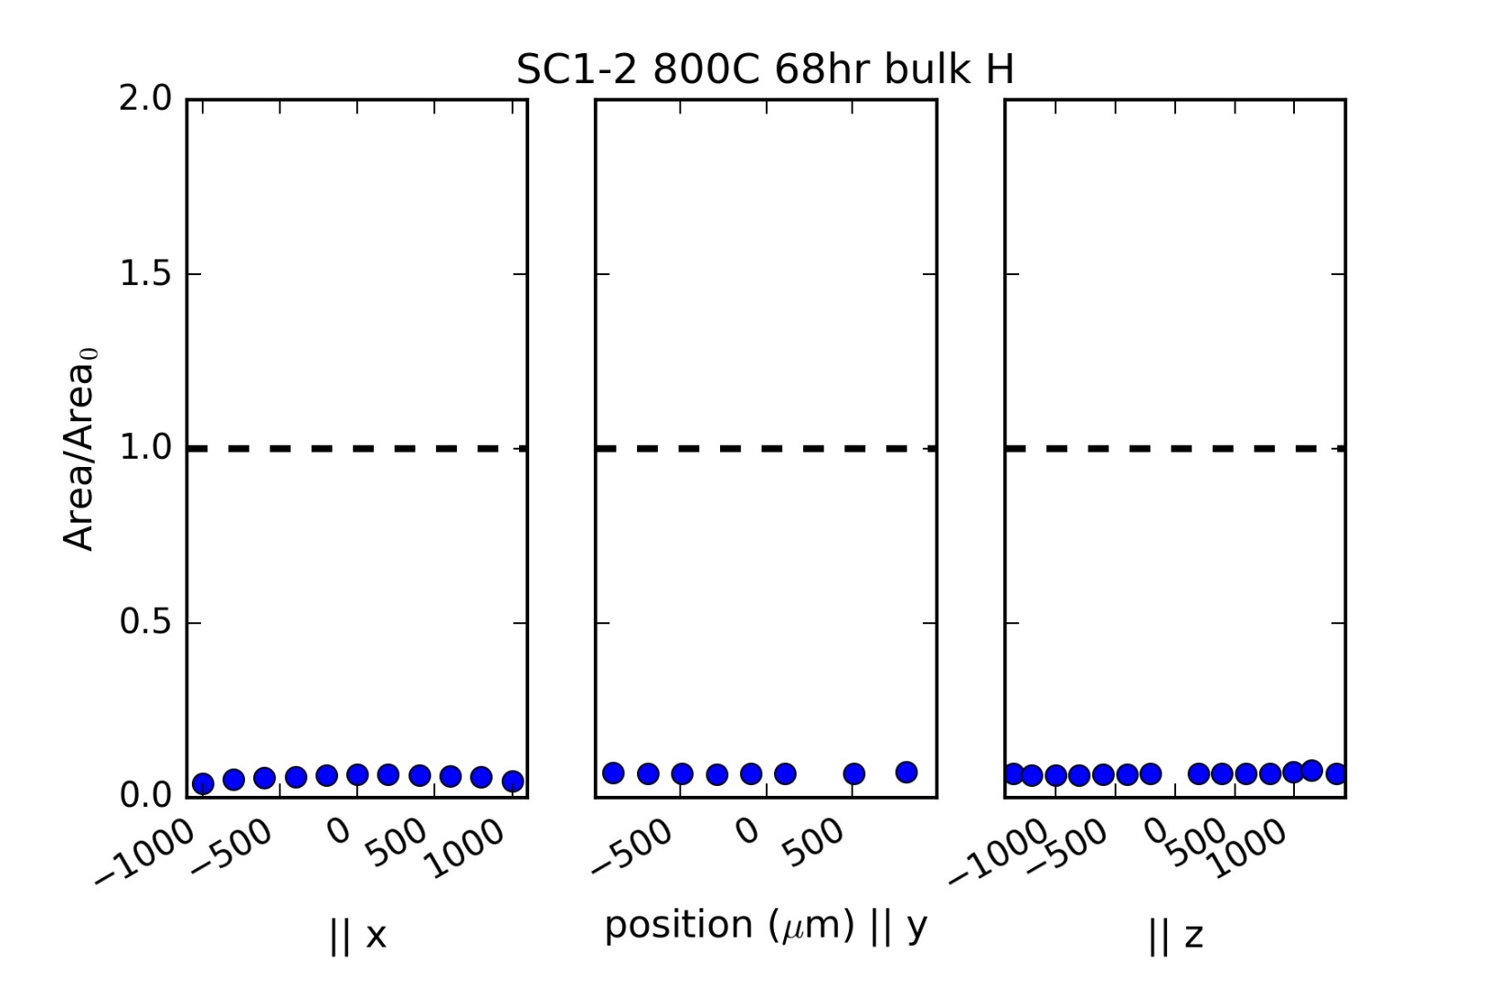

Slide 23
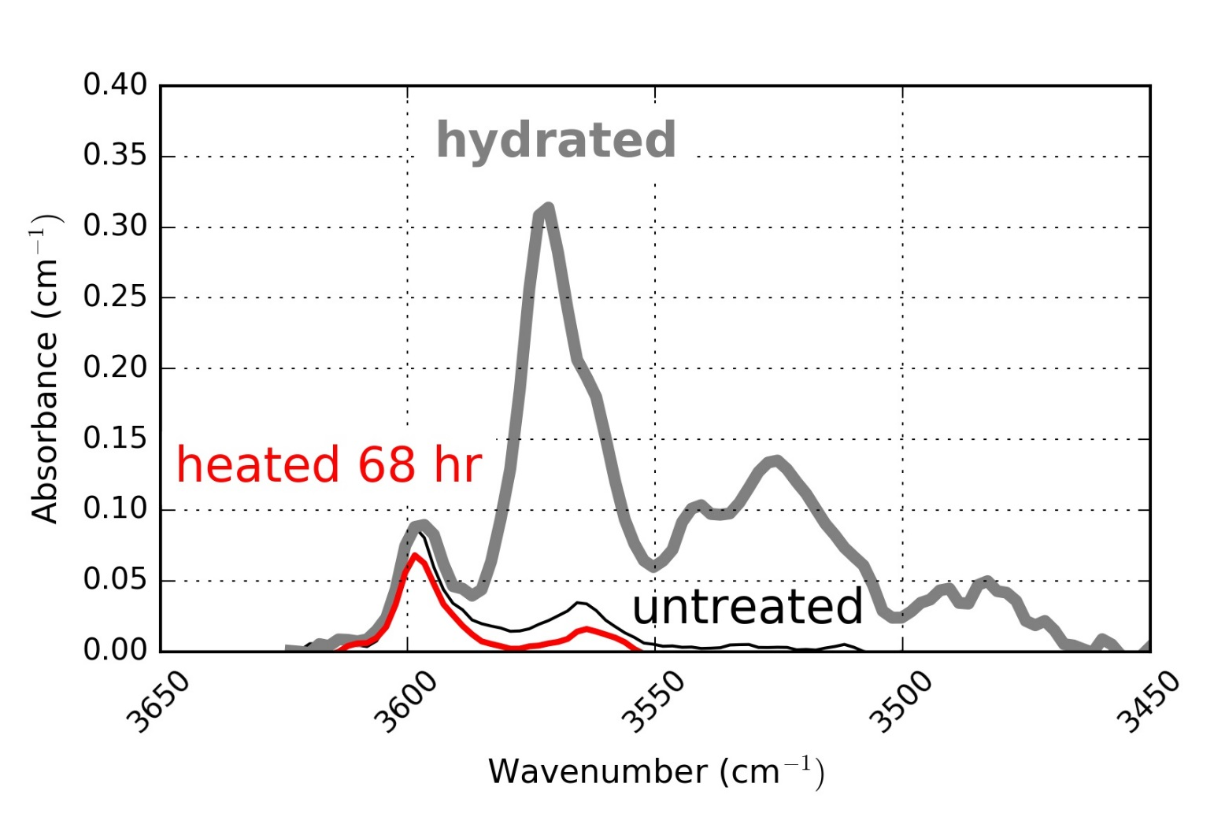

Slide 24
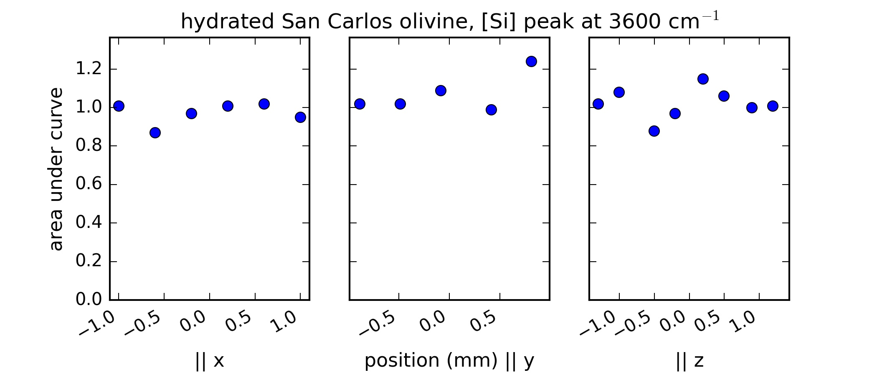


Slide 25
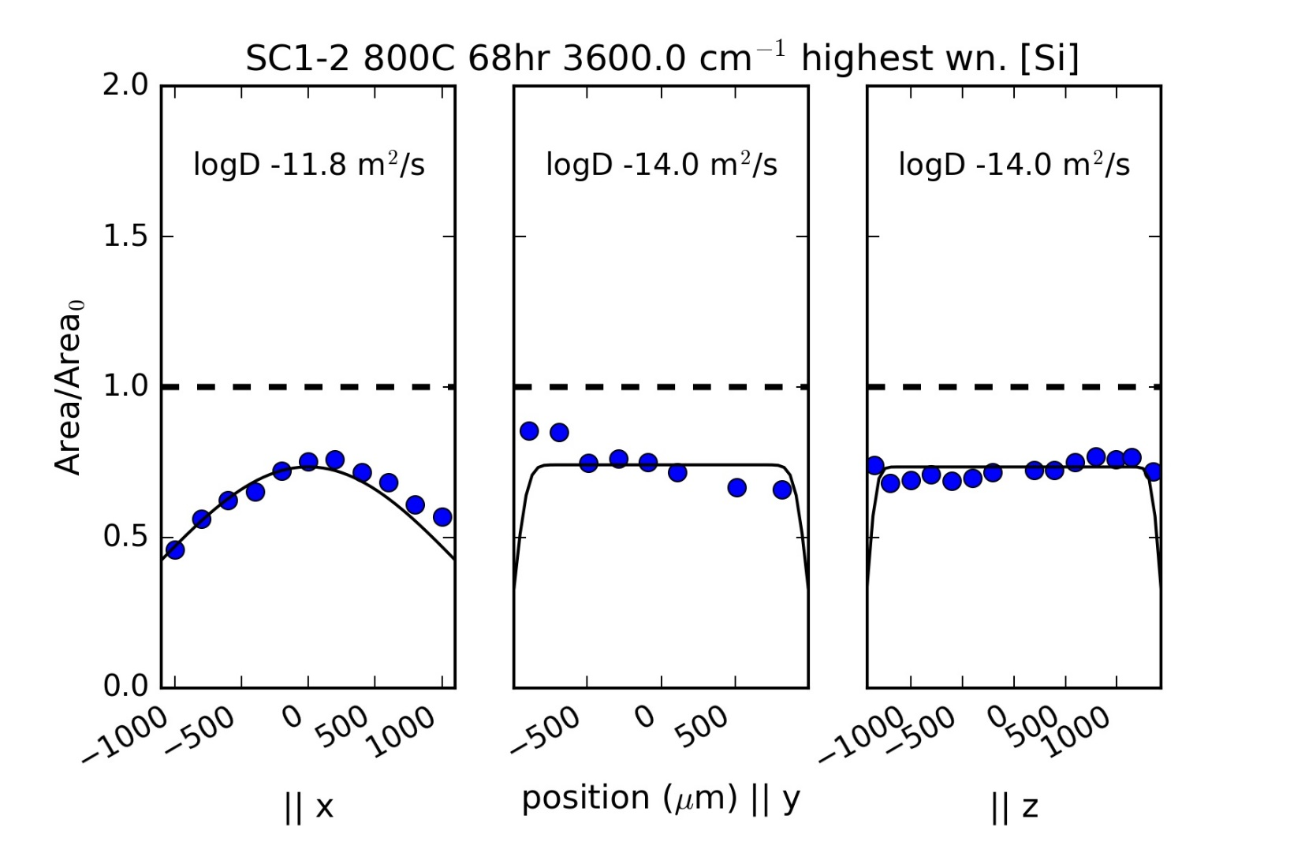

Slide 26
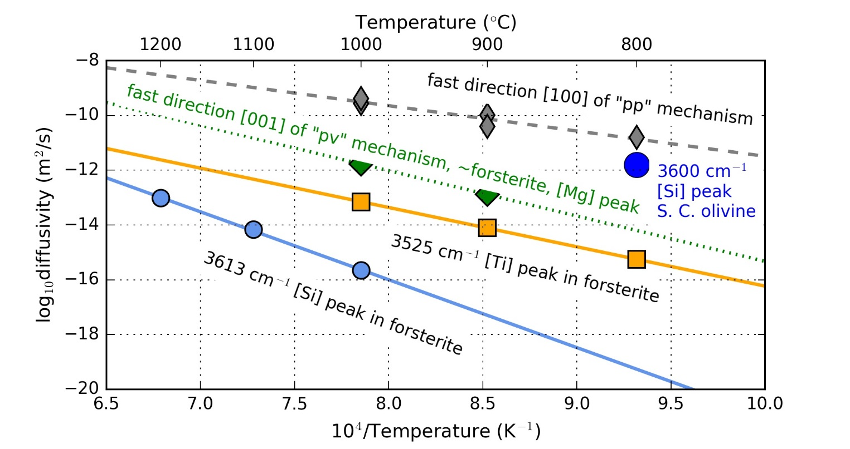

Slide 27
Hydrated San Carlos olivine initial areas
Total FTIR peak area

Slide 28
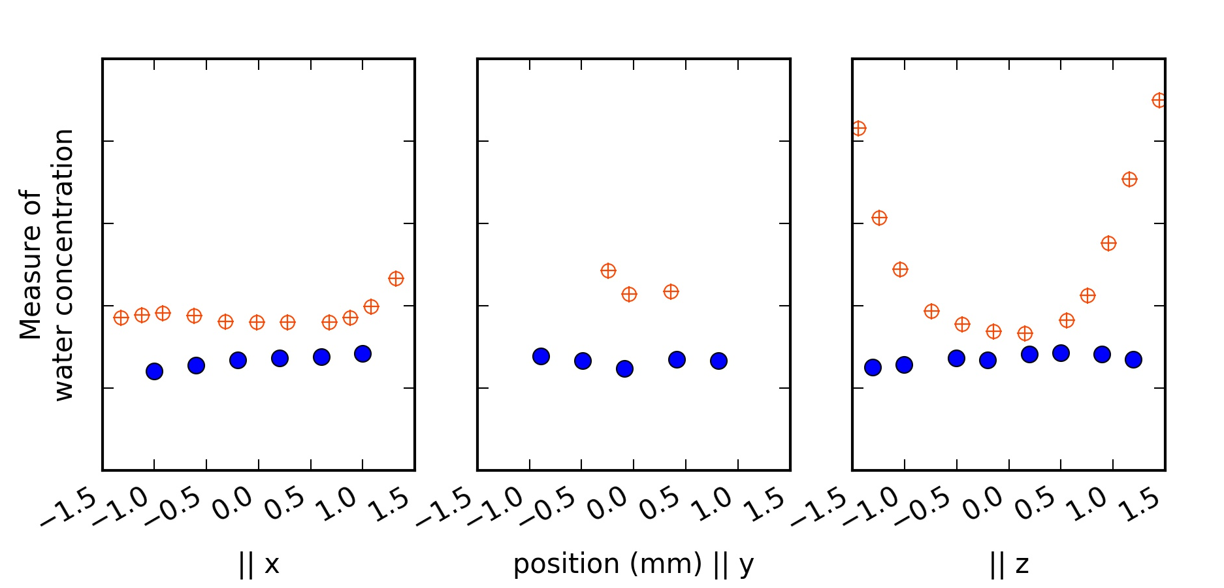
San Carlos olivine hydrated at 1000°C 3 hours longer than needed (7hr total) to complete very fast “pp” diffusion
(Fast direction) relatively slow diffusion
FTIR peak area as measure of water concentration
relatively fast diffusion
(Fast direction)

Slide 29
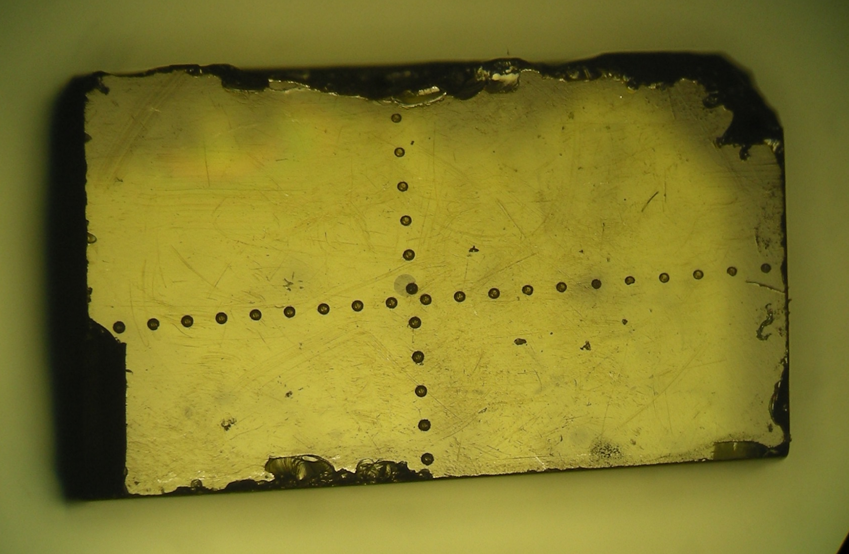
Olivine phenocryst from Kilauea Iki Ep. 1
Laser spots 100 microns apart

Slide 30
Conclusions and ongoing work
I performed a reversal, putting water in and taking it out of the same olivine
Reproduced two-stage hydration of Kohlstedt & Mackwell, 1998
H⁺ was incorporated as
4 peaks likely (4H)_{Si} [Si]
2 Ti-clinohumite peaks, (Ti)_{Mg}(2H)_{Si} [Ti]
Dehydration within the fast ‘proton-polaron’ regime mirrored hydration
[100] is the fast direction
All peaks diffuse orders of magnitude faster than during synthetic forsterite dehydration
2 of the [Si] peaks diffuse more slowly Likely retain information about deep water (Padrón-Navarta et al. 2014’s 3613 cm⁻¹)
Ongoing work is focused on sequentially dehydrating an olivine phenocryst

